Slide 1
7- Sorting Lists

Slide 2
context
listObject.sort() 3
listObject.sort(reverse=True) 4
Ex.1 5
sorted(<iterable>) | Built in function 6
Sorting a list of complex objects 9
listObject.sort(key=functionName) 11

Slide 3

listObject.sort()
sorted in ascending order

Slide 4
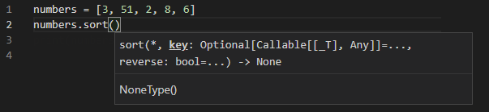
listObject.sort(reverse=True)
sort method takes two parameters
Key
Reverse
we can use to change the sort order

Slide 5

Ex.1

Slide 6
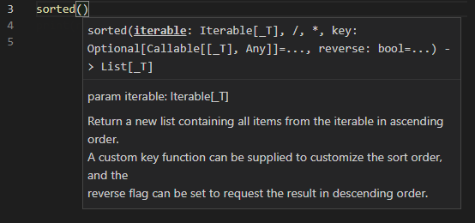
sorted(<iterable>) | Built in function
takes an iterable
this will return a new list that is sorted
unlike the sort method this will not modify the original list, it will return a new sorted list.

Slide 7



Slide 8



Slide 9
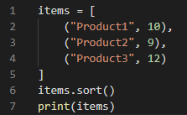
Sorting a list of complex objects
what if you're dealing with a list of complex objects?
nothing is changed here because Python doesn't know how to sort this list

Slide 10
In situations like this we need to define a function that Python will use for sorting lists
This function should take an item like this topple And it should return a value that will be used for sorting. (price)
we want to sort these items based on their price
Python is dealing with a list of numbers and it can easily sort that list.

Slide 11
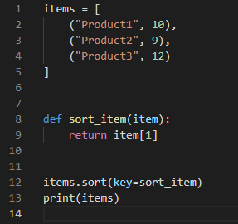
look at the sort method, The first parameter is key and this is where we need to pass our sorting function.
So we pass sort_item, but note that I'm not calling this function, I'm simply passing a reference to this function. When Python attempts to sort this list of items, it gets each item and it will pass each item to our sort function.

